Slide 1
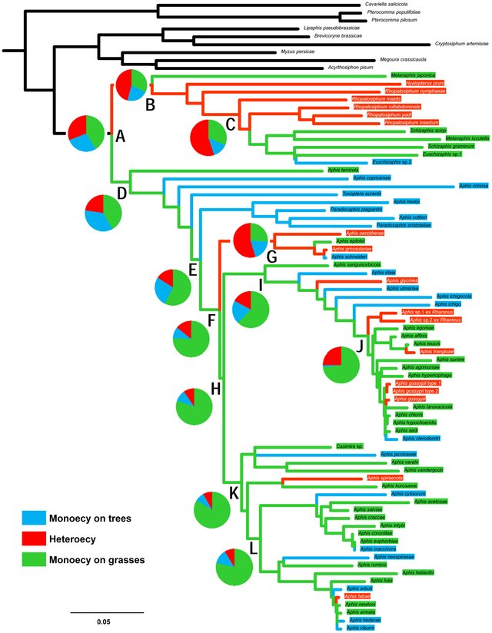
Ancestral State Reconstruction of discrete and continuous traits
Jackie Childers
November 7,2019
Figure from Kim et al. 2011
Notes:
Kim, Hyojoong, Seunghwan Lee, and Yikweon Jang. "Macroevolutionary patterns in the Aphidini aphids (Hemiptera: Aphididae): diversification, host association, and biogeographic origins." PLoS One 6.9 (2011): e24749.

Slide 2
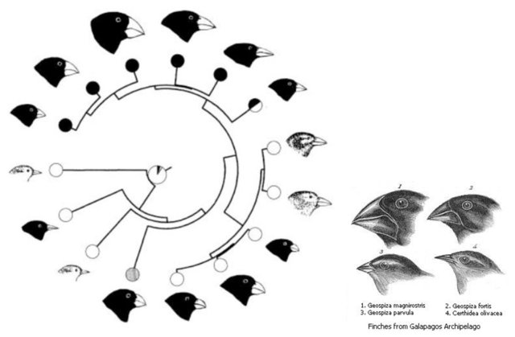
Outline
Overview of Ancestral State Reconstruction
Phylogenetic Methods
-Maximum likelihood
-Bayesian Inference
Discrete and Continuous Trait Models
Other Considerations
Figure from Schluter 2000
Notes:
Overall the goal of this talk is to provide an overview of the uses of ASR and the types of evolutionary questins we can ask, the different types of approaches and models and how they work, which hopefully will lead into a discussion into some of the methodological considerations when implementing it

Slide 3
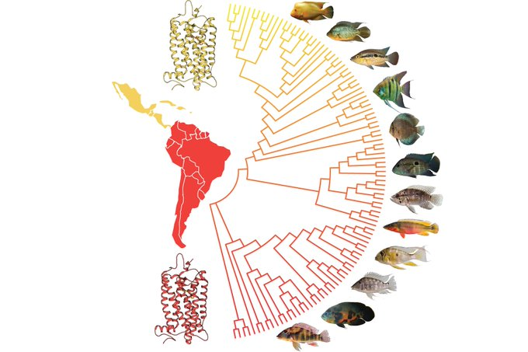
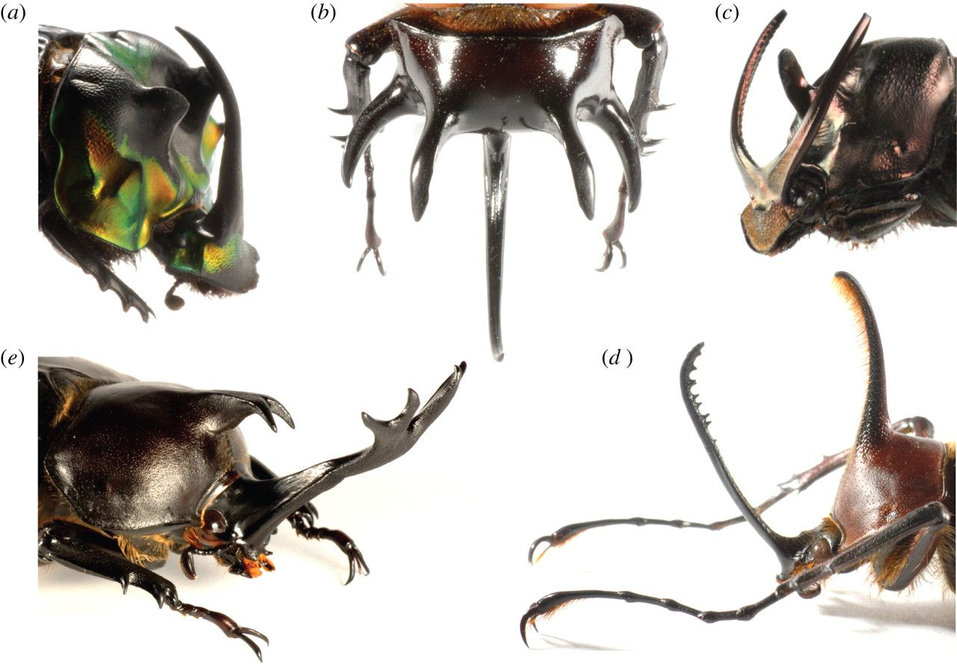
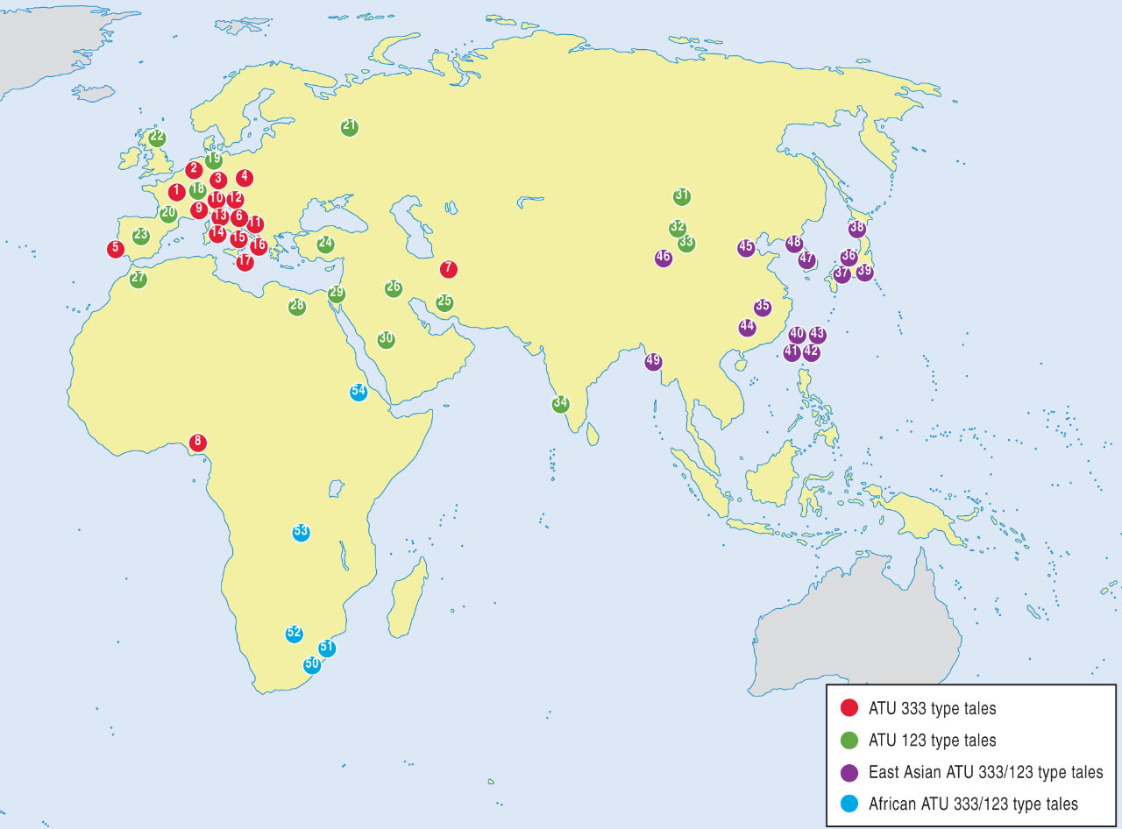
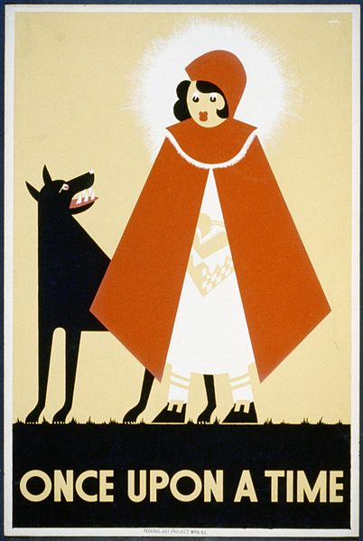
Ancestral State Reconstruction
Purpose : understand patterns/timing of character evolution across the tree of life
General approach: taking measured characters from extant individuals/populations and using phylogenetic methods to infer ancestral character states.
Character examples:
1. Molecular – nucleotide/amino acid sequences (proteins), genome composition
2. Phenotypic – morphology, coloration, behavior, ecology
3. Phylogeography – ancestral range reconstruction
4. Non-biological- ancient languages and cultural practices
Rhodopsin protein evolution in New World Cichlids (Hauser et al. 2017))
Male weaponry in stag horn beetles
Phylogeography of Little Red Riding Hood folktale (Tehrani 2013)
Notes:
Hauser, F. E., Ilves, K. L., Schott, R. K., Castiglione, G. M., López-Fernández, H., & Chang, B. S. (2017). Accelerated evolution and functional divergence of the dim light visual pigment accompanies cichlid colonization of Central America. Molecular biology and evolution, 34(10), 2650-2664.

Slide 4
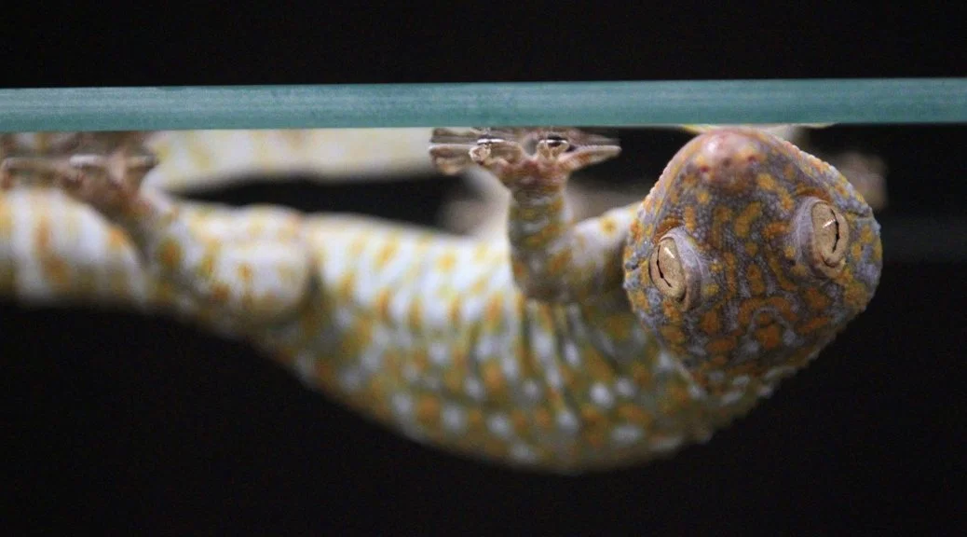
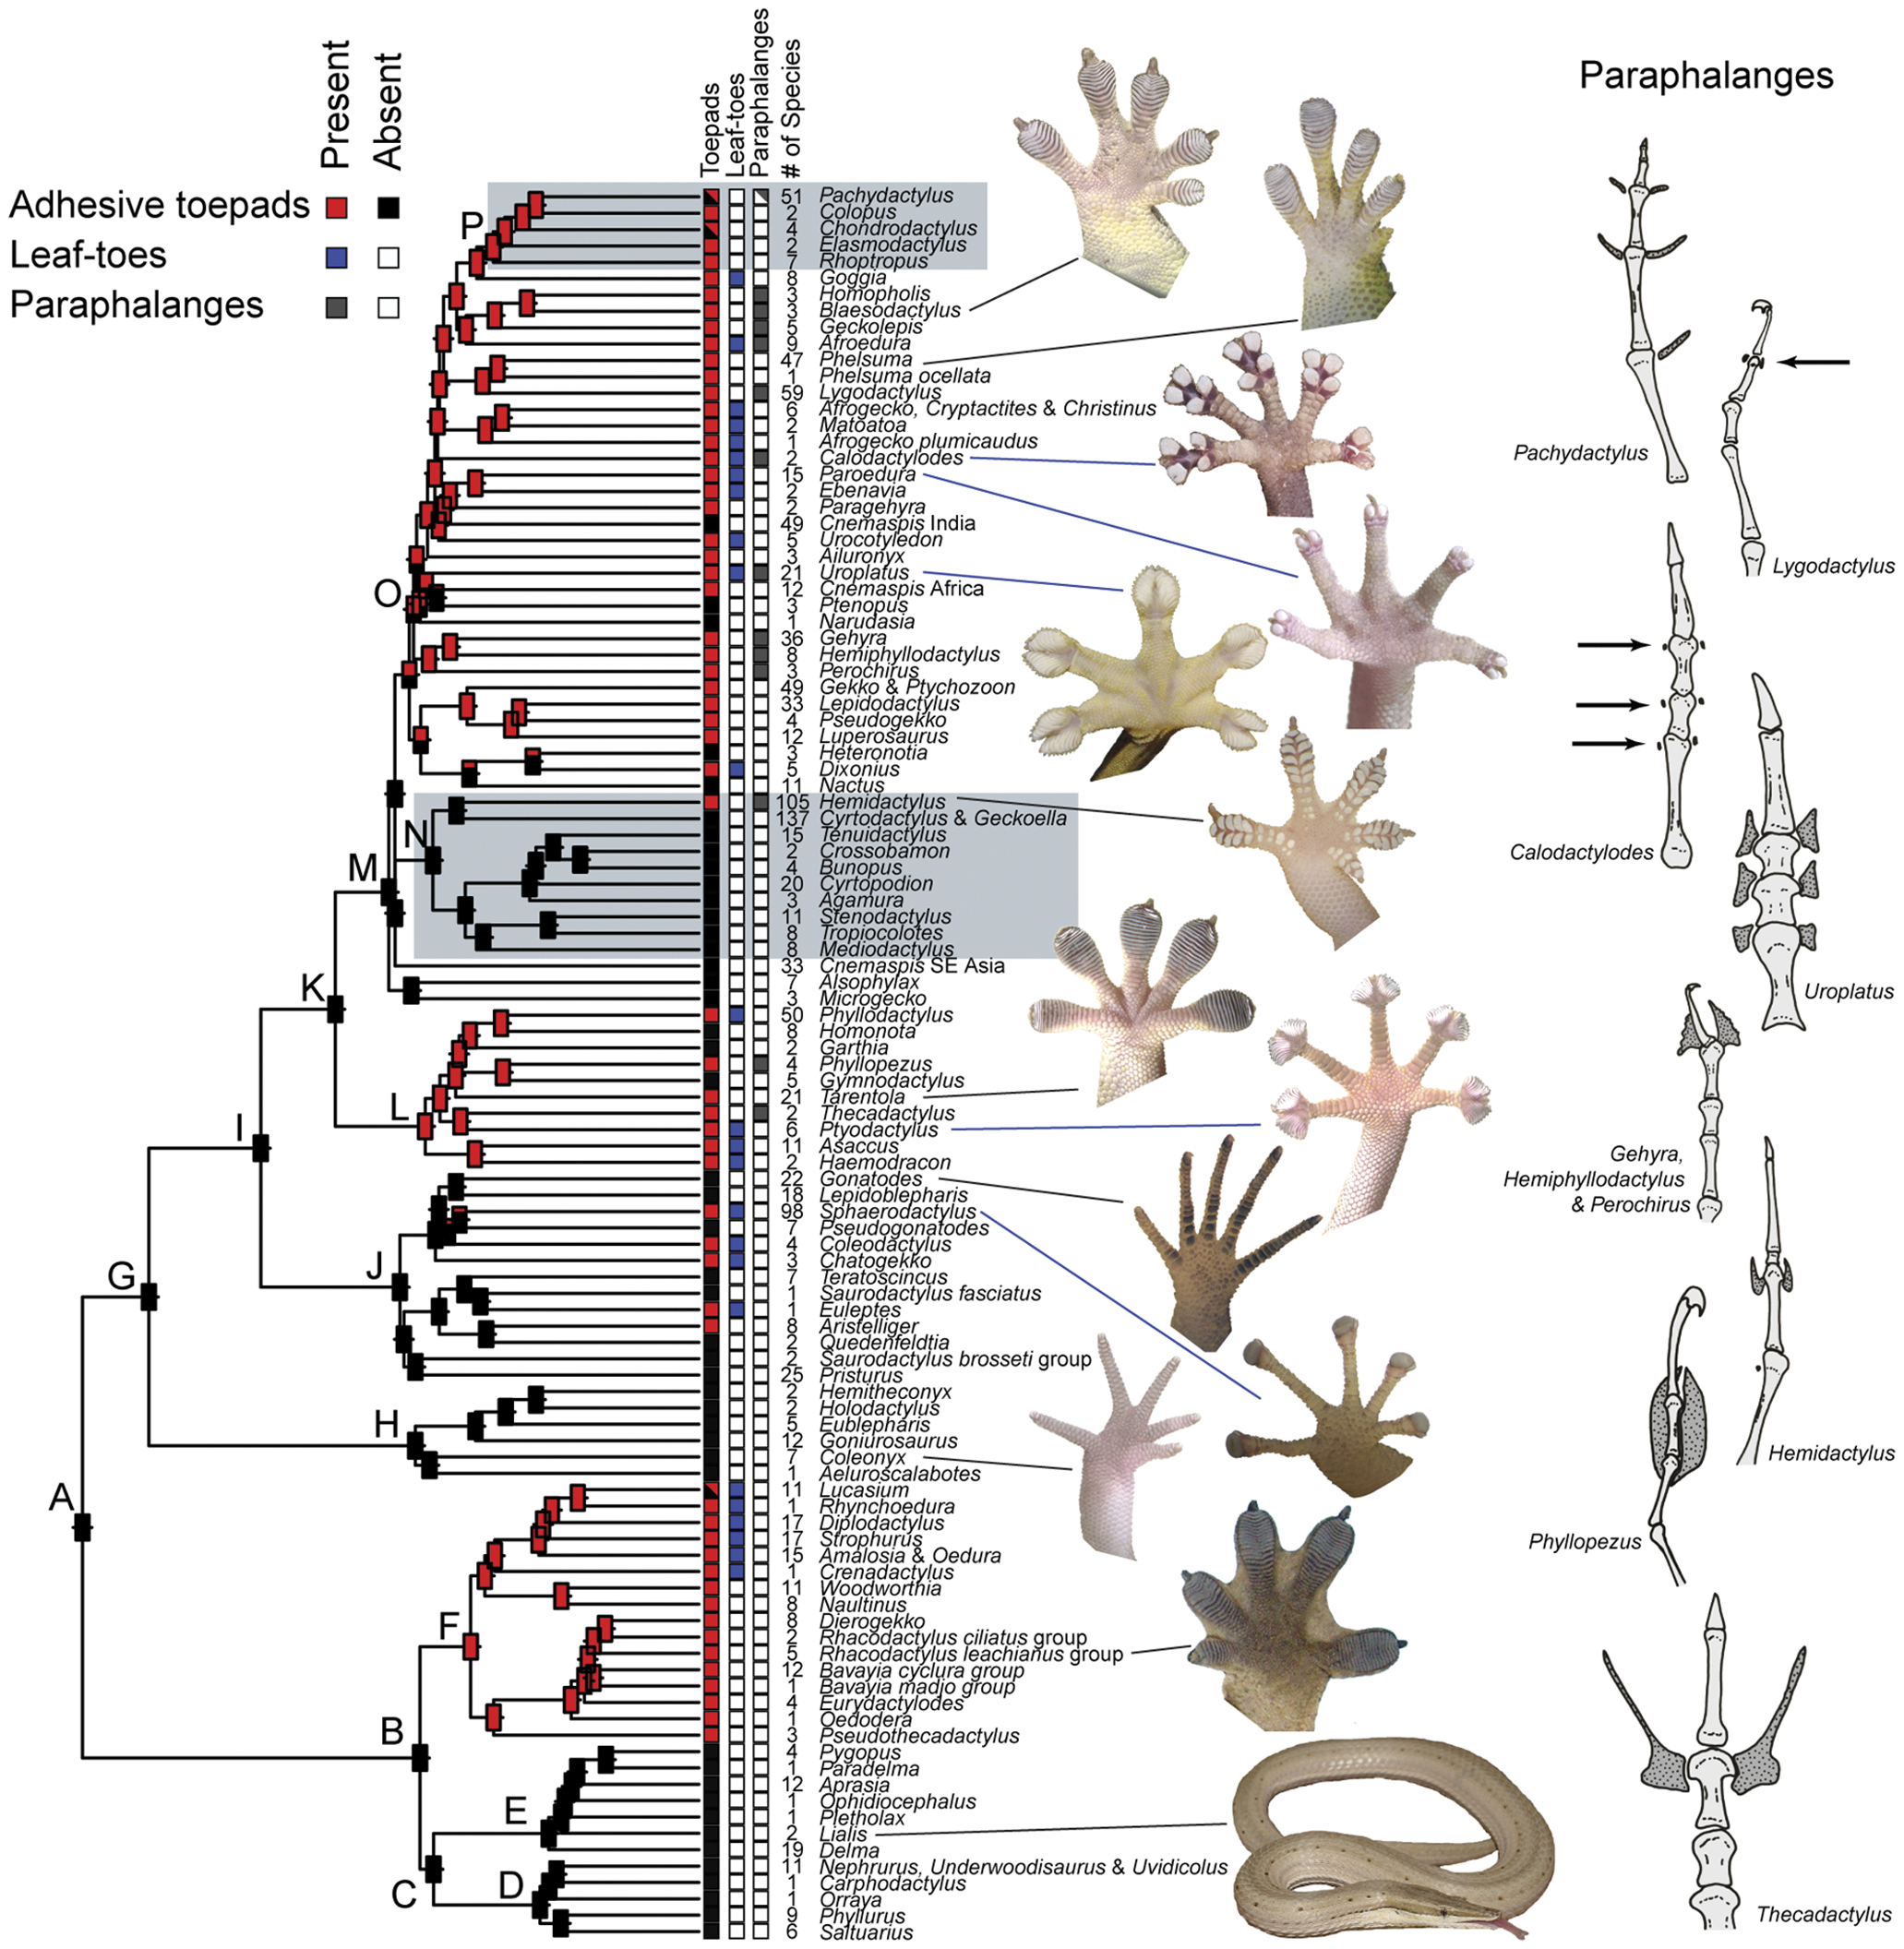
Can ask questions like:
What is the ancestral origin of a character?
How many times has it been gained or lost?
Are character states related to species diversification rates?
Gamble et al. 2012
-Non-adhesive toe pad is the ancestral state for all geckos
-Adhesiveness has been gained and lost multiple times
-No apparent relationship between diversification rates and toe-pad adhesion
Notes:
Gamble, T., Greenbaum, E., Jackman, T. R., Russell, A. P., & Bauer, A. M. (2012). Repeated origin and loss of adhesive toepads in geckos. PLoS One, 7(6), e39429.

Slide 5
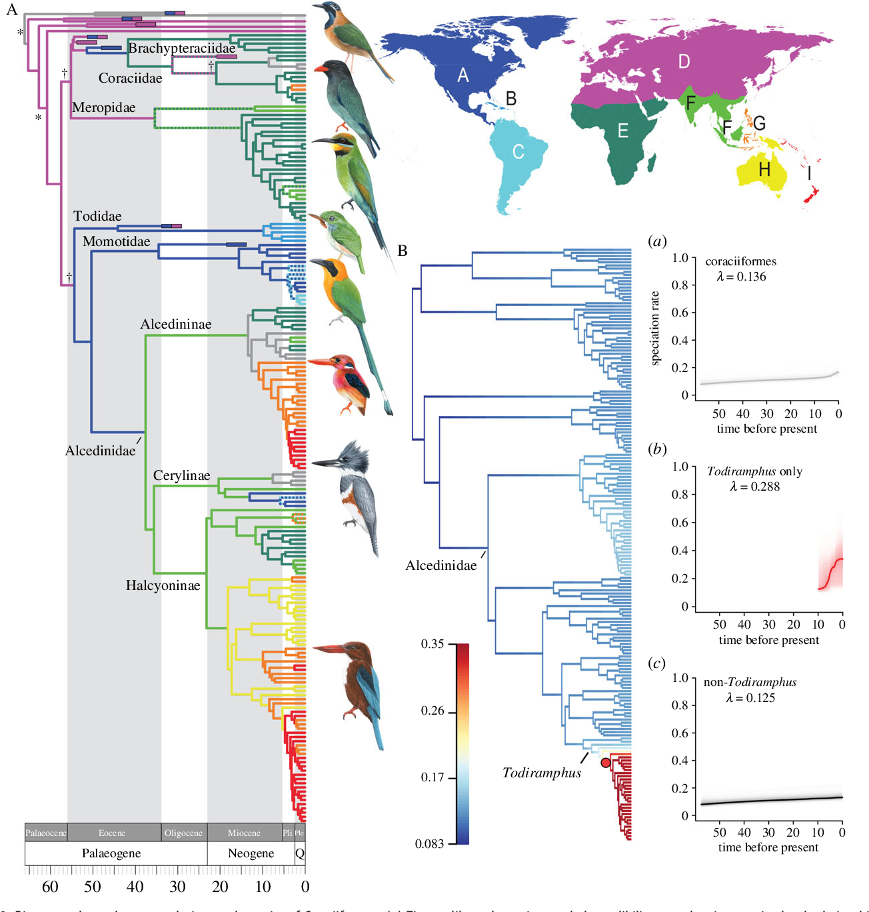
Can also use ASR to reconstruct the biogeographical history of a clade:
Geographic origins
Patterns and timing of dispersal events
Species diversification
McCullough et al. 2019
-Major lineages of Coraciiformes arose in Laurasia ~57 MA followed by independent dispersals to equatorial regions
-Diversification of genera in the tropics during the Miocene and Pliocene
Notes:
McCullough, J. M., Moyle, R. G., Smith, B. T., & Andersen, M. J. (2019). A Laurasian origin for a pantropical bird radiation is supported by genomic and fossil data (Aves: Coraciiformes). Proceedings of the Royal Society B, 286(1910), 20190122.

Slide 6
Phylogenetic Methods
Phylogenetic methods include maximum parsimony (MP), maximum likelihood (ML) and Bayesian Inference (BI) approaches
Data input requirements include (1.) Observed (extant) character states (2.) Evolutionary relationships among taxa (phylogeny or nucleotide sequences)
MP
Methods will reconstruct a tree with ancestral character states that minimize the total number of character state changes needed to explain the observed (extant) character states at tips
Commonly used in historical biogeography studies
ML/BI
Methods will estimate optimal model given the observed data. Models contain parameters (evolutionary models, tree topology and branch lengths). Parameter values can be assigned a priori or estimated.
Goal of both approaches is to estimate parameter values for the internal (ancestral) node character states
Notes:
in the form of a phylogeny or nucleotide sequences
Both bi and ml will assume what the tree and model parameters of
Empirical application of ASR should involves model testing

Slide 7
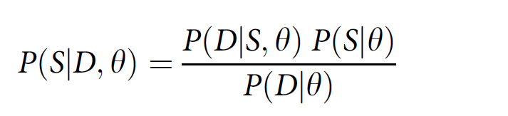
Likelihood of observed data
Prior probability of ancestral states for a given model and tree
Posterior probability of ancestral states
Probability of the data for a given model and tree
S = ancestral character states
D= observed data
θ= evolutionary model and phylogenetic tree
Equation assumes that model and tree are known, can be modified to estimate model and tree parameter values (topology and branch lengths) in addition to ancestral states
ML Goal: find the parameter values that maximize the probability of the observed data given the hypothesis (model of evolution and phylogeny)
- ML will recover a ML tree with ancestral character states (point estimate)
BI Goal: Generate posterior probability distributions of parameters using the likelihood of the observed data to update one’s belief (prior distribution)
-BI will recover a majority-rule consensus tree based on the posterior probabilities, providing a broader assessment of uncertainty in parameter estimates
Joy et al. 2016
Notes:
Heres bayes theorem showing parameter variables that are incorporated into both ML and BI analyses

Slide 8
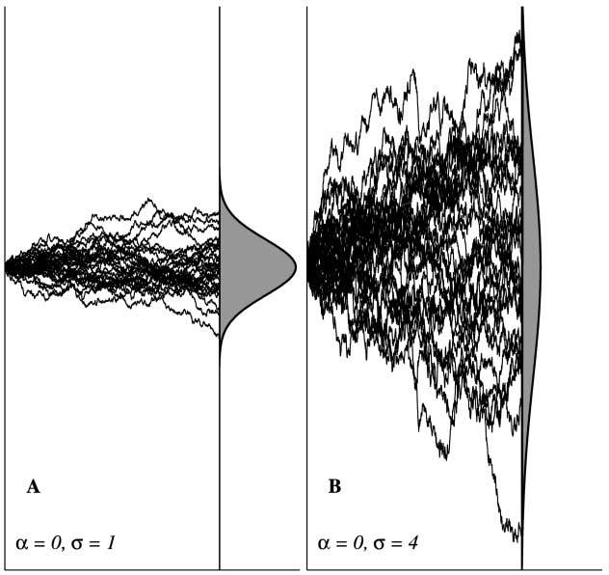
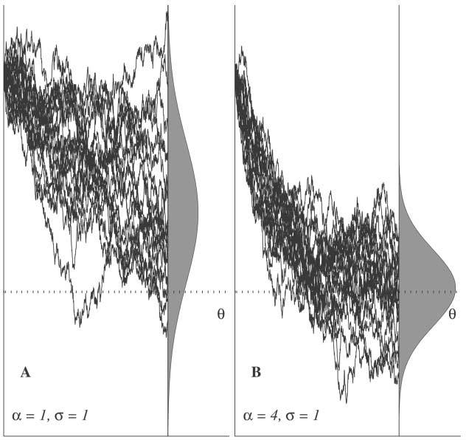
Character trait models
Various models for estimating ancestral states of discrete and continuous characters
Binary states (Presence/absence, nocturnal/diurnal)
Multi-states (habitat types, geographic regions)
All models assume that trait evolution can be modeled as a stochastic process
Discrete trait evolution is modeled by a Markov chain process (“random walk”)
Continuous trait evolution is modeled by Brownian motion or Ornstein-Uhlenbeck processes
Brownian Motion
Orstein-Uhlenbeck
Y axis = Trait value
“Rubberband”
Additional optimal value parameter (θ)
Stronger pull towards θ the further it strays from it
Ideal if trait is under stabilizing selection
“Random walk”
Drift (σ ) can be weak (l) or strong (r)
Overall change from starting value is zero
σ
X axis = Time
Butler and King 2004
Notes:
selection (α) is zero in brownian motion model
Stronger selection (α) in right causes it to reach optimal value more quickly
Drift is zerio in right
Evolutionary model of character state changes is a “random walk” process.
Continuous-time Markov chains model this “random walk” process to estimate the rate of evolution for traits. Assumes:
Probability of changes along branches are independent of prior changes
Transitions along each branch are independent of changes elsewhere in the tree
Transitions are instantaneous – assumes that “transitional periods” are short
Can be violated when character state transitions are dependent on preorder arrangement
Multi-state -, can only be in one state at a time, no polymorphism
vs
Biogeographic area- north vs. south america, africa vs. asia
Transitions are not instantaneous, can be In multiple states at a time
Butler, M. A., & King, A. A. (2004). Phylogenetic comparative analysis: a modeling approach for adaptive evolution. The American Naturalist, 164(6), 683-695.

Slide 9
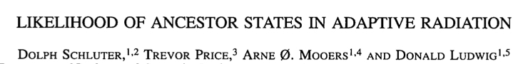
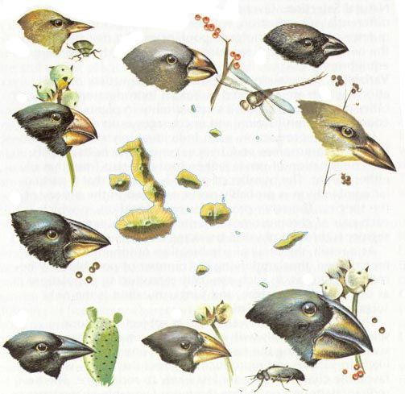
Classic paper comparing MP and ML approaches to ASR of discrete and continuous characters in model adaptive radiation systems using MC and BM models.
Systems included diet in Darwin’s finches, gall wasps, swordtails, and Anolis lizards
Darwin’s Finches example: three diet categories
Results indicate that there have been 2-3 major dietary shifts
ML ancestral states vary depending on whether transition
rates (q) are equal (b) or allowed to vary (c) between states
Ancestral diet is either insectivore or folivore
Other take homes:
1. ML and MP perform similarly if state changes are rare
1. Uncertainty increases as changes become more frequent and transition rates are allowed to vary--- quantifying uncertainty requires a model of evolution
Notes:
MC and BM- markov chain and brownian motion

Slide 10
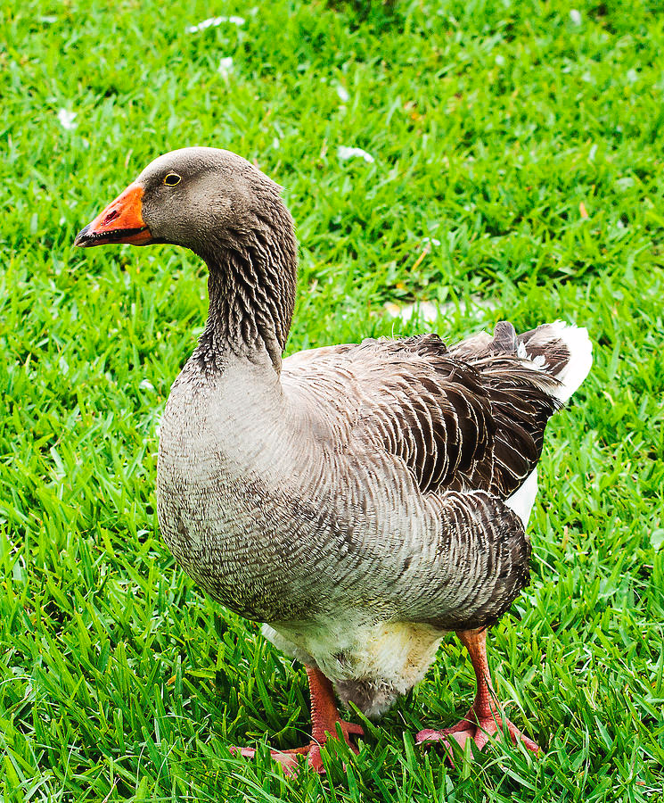
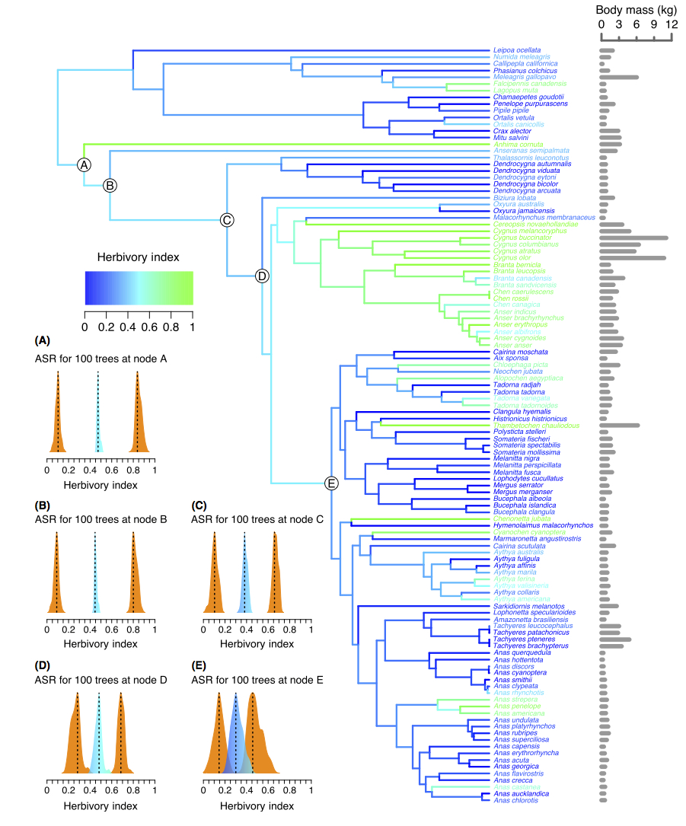
Observation: herbivory is rare among birds and usually associated with flightlessness and larger body size. Question: How has herbivory evolved over time in Anseriformes and is it correlated with body size?
Diet treated as continuous characters for each species using Herbivory index
Trait Model testing
-Compare model fit between Brownian motion and OU models (AIC score)
Phylogenetic correlation tests between mean body mass and HI – independent contrasts
Results
- Multiple transitions towards a predominantly herbivorous diet
-Diet is not correlated with body mass
Ollsen 2015
Notes:
independent contrasts method of Felsenstein (1985) for estimating the evolutionary correlation between characters.
Approach allows you to see variation in a character across a phylogeny
Trait model testing is part of the ASR analysis
Emphasize that theyre doing both ASR and model testing to see which is a better fit to the data- brownian vs. OU vs. others
Emphasize the utility of ASR allows you to infer the history of a character, how its varied across the branches of a tree

Slide 11
Other considerations
ASR tends to be less reliable toward the root of the tree, even when phylogenetic relationships are resolved (Oakley and Cunningham, 2000)
Increased taxon sampling can improve character state estimations (Maddison, 1995; Martins 1999; Salisbury and Kim 2001)
Fossil calibrations have been found to greatly improve ancestral state reconstruction inferences (Finarelli and Flynn 2006; Slater et al. 2012)
Confounding effect of diversification rate on ancestral state reconstruction analyses (Maddison 2006)
Most models assume that branch lengths are independent of character states
Newer character state dependent diversification models try to accommodate for this (HiSSE: Beaulieu and O’Meara, 2016; FiSSE: Rabosky and Goldberg, 2017)
Notes:
Oakley, T. H., and C. W. Cunningham. 2000. Independent contrasts succeed
where ancestor reconstruction fails in a known bacteriophage
phylogeny. Evolution 54:397-405.
Maddison, W. P. 1995. Calculating the probability distributions of ancestral
states reconstructed by parsimony on phylogenetic trees. Syst.
Biol. 44:474-^181.
Martins, E. P. 1999. Estimation of ancestral states of continuous characters:
A computer simulation study. Syst. Biol. 48:642-640.
Slater GJ, Harmon LJ, Alfaro ME. Integrating fossils with molecular phylogenies improves inference of
trait evolution. Evolution. 2012; 66(12):3931–44.
Salisbury, B. A., and J. H. Kim. 2001. Ancestral state estimation and
taxon sampling density. Syst. Biol. 50:557-564.
Beaulieu, J.M., and B.C. O’Meara. (2016). Detecting hidden diversification shifts in models of trait-dependent
speciation and extinction. Syst. Biol. 65:583-601
Rabosky, D. L., & Goldberg, E. E. (2017). FiSSE: A simple nonparametric test for the effects of a binary character on lineage diversification rates. Evolution, 71(6), 1432-1442.

Slide 12
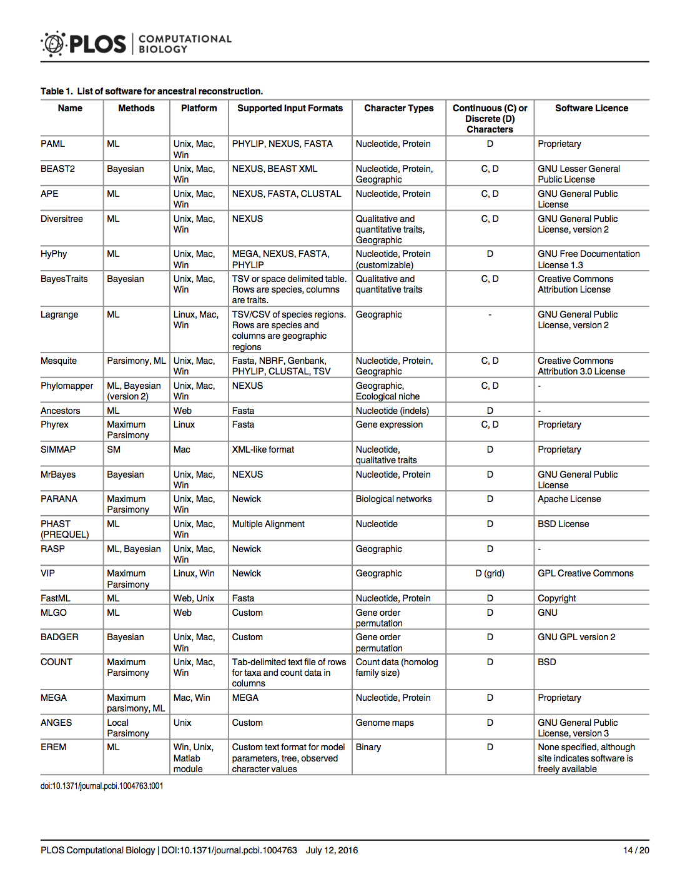
Don’t forget BEAST and RevBayes!
Joy et al. 2016
Notes:
Drummond, A. J., & Rambaut, A. (2007). BEAST: Bayesian evolutionary analysis by sampling trees. BMC evolutionary biology, 7(1), 214.
Höhna, Sebastian, Michael J. Landis, Tracy A. Heath, Bastien Boussau, Nicolas Lartillot, Brian R. Moore, John P. Huelsenbeck, and Fredrik Ronquist. "RevBayes: Bayesian phylogenetic inference using graphical models and an interactive model-specification language." Systematic biology 65, no. 4 (2016): 726-736.

Slide 13
Figure references
Kim, Hyojoong, Seunghwan Lee, and Yikweon Jang. "Macroevolutionary patterns in the Aphidini aphids (Hemiptera: Aphididae): diversification, host association, and biogeographic origins." PLoS One 6.9 (2011): e24749.
Schluter, Dolph. The ecology of adaptive radiation. OUP Oxford, 2000.
Hauser, F. E., Ilves, K. L., Schott, R. K., Castiglione, G. M., López-Fernández, H., & Chang, B. S. (2017). Accelerated evolution and functional divergence of the dim light visual pigment accompanies cichlid colonization of Central America. Molecular biology and evolution, 34(10), 2650-2664.
Tehrani, Jamshid J. "The phylogeny of little red riding hood." PloS one 8.11 (2013): e78871.
Gamble, T., Greenbaum, E., Jackman, T. R., Russell, A. P., & Bauer, A. M. (2012). Repeated origin and loss of adhesive toepads in geckos. PLoS One, 7(6), e39429.
McCullough, J. M., Moyle, R. G., Smith, B. T., & Andersen, M. J. (2019). A Laurasian origin for a pantropical bird radiation is supported by genomic and fossil data (Aves: Coraciiformes). Proceedings of the Royal Society B, 286(1910), 20190122.
Butler, M. A., & King, A. A. (2004). Phylogenetic comparative analysis: a modeling approach for adaptive evolution. The American Naturalist, 164(6), 683-695.
Maddison, W. P. (2006). Confounding asymmetries in evolutionary diversification and character change. Evolution, 60(8), 1743-1746.
Oakley, T. H., and C. W. Cunningham. 2000. Independent contrasts succeed where ancestor reconstruction fails in a known bacteriophage phylogeny. Evolution 54:397-405.
Maddison, W. P. 1995. Calculating the probability distributions of ancestral states reconstructed by parsimony on phylogenetic trees. Syst. Biol. 44:474-^181.
Martins, E. P. 1999. Estimation of ancestral states of continuous characters:A computer simulation study. Syst. Biol. 48:642-640.
Slater GJ, Harmon LJ, Alfaro ME. Integrating fossils with molecular phylogenies improves inference oftrait evolution. Evolution. 2012; 66(12):3931–44.
Salisbury, B. A., and J. H. Kim. 2001. Ancestral state estimation and taxon sampling density. Syst. Biol. 50:557-564.

Slide 14
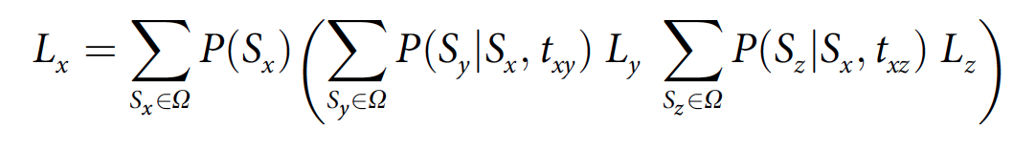
Maximum likelihood
Calculating the likelihood of the subtree rooted at node x, with direct descendants y and z
At each node the likelihood of its descendants is summed over all possible ancestral states S_{i} = character state of the i-th node
T_{ij} = branch length (i.e. evolutionary time) between nodes i and j
Ω = set of possible character states
Resulting tree will possess a set of character states S_{x} for all x internal nodes that maximize the likelihood of the observed data for a given tree.

